Slide 1
ERL/FEL Status & Activities at JLab

Slide 2
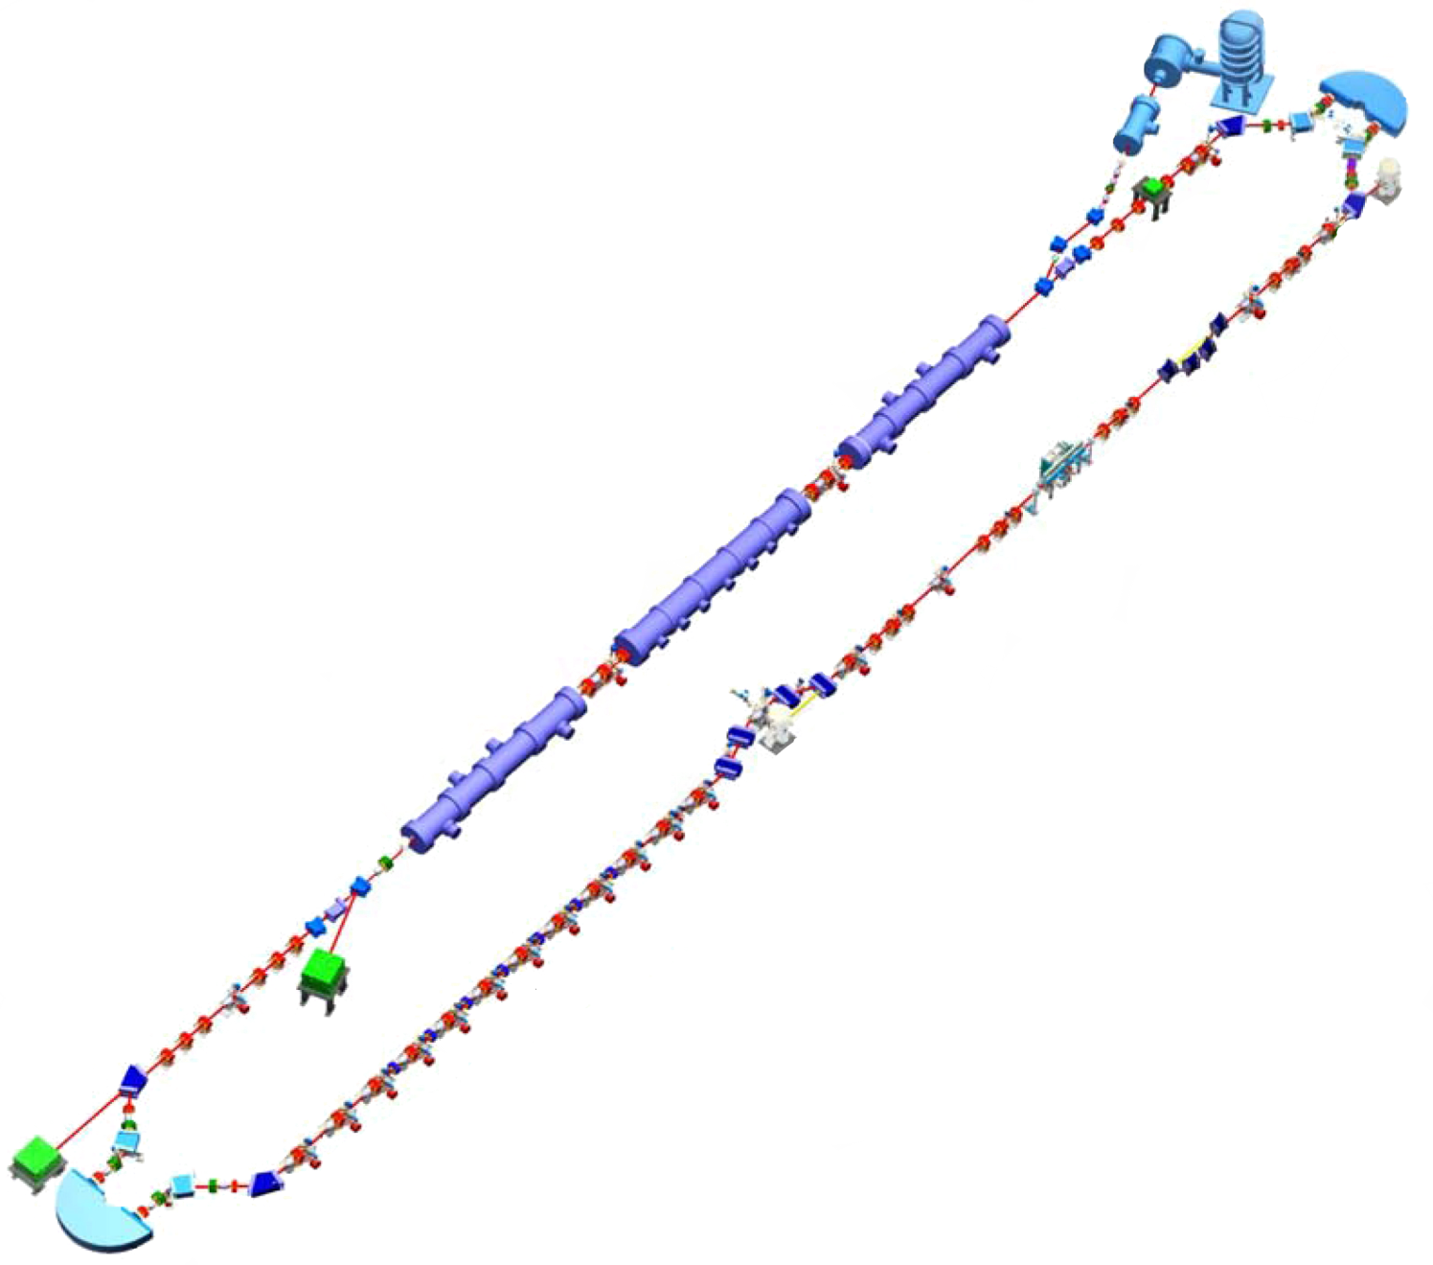
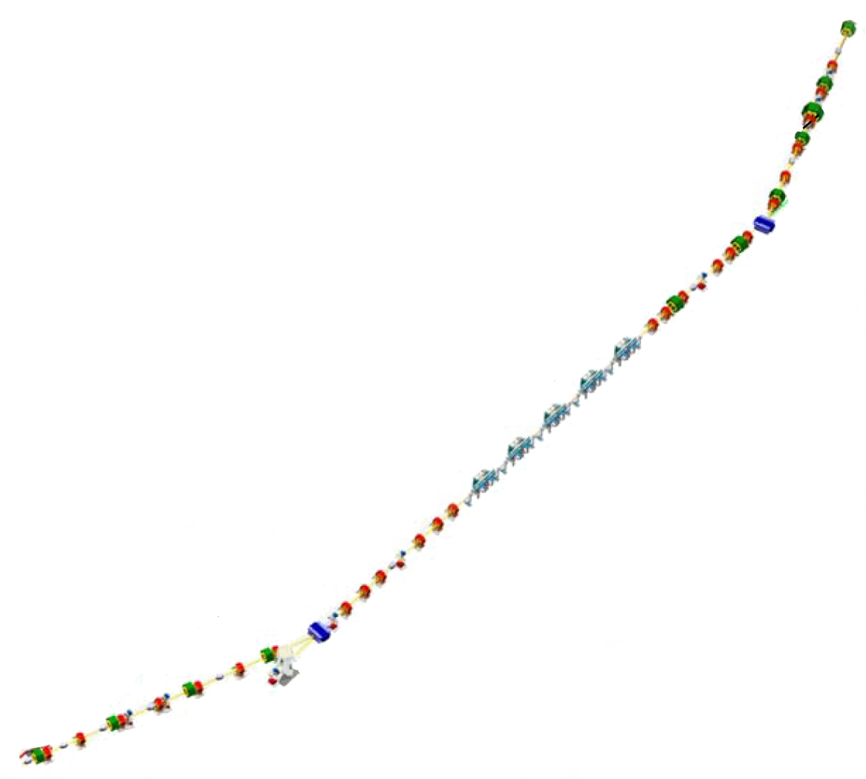
3 sources of CW coherent radiation
DC Gun
THz beamline
  ~10s of W @ 0.2 – 1.5 THz
IR FEL
  High power FEL, optics, beam dynamics studies
  14+ kW at 1.6 microns; several kW @ multiple wavelengths
UV FEL
  Recently commissioned (summer 2010)
  High power (100+W) CW 700, 400 nm
  Coherent harmonics into VUV (10 eV)
+ previous (IR Demo)/potential future
Compton source…
IR Wiggler
SRF Linac
Bunching Chicane
THz Line
UV FEL Transport Line
Dump

Slide 3
ERL Parameters (Achieved)
Parameter | IR | UV
Energy (MeV) | 88-165 | 135
I_{ave} (mA) | 9.1 | 2
Q_{bunch} (pC) | 135 | 60
ε_{N} transverse/longitudinal (mm-mrad/keV-psec) | 8/75 | 5/50
σ_{δp/p,} σ_{l} (fsec) | 0.4%, 160 | 0.4%, 100
I_{peak} (A) | 400 | 250
FEL repetition rate (MHz) (cavity fundamental 4.6875) | 0.586-75 | 1.172-18.75
η_{FEL} | 2.5% | 0.8%
ΔE_{full} after FEL | ~15% | ~7%

Slide 4
Architecture
DC photocathode gun (350 keV)
9 MeV booster
Penner bend merger
3 cryomodule linac
Bates bend arcs
compression in chicane for IR;
arc/bypass for UV
nonlinear compaction management &
  RF curvature compensation; energy compression during recovery
DC Gun
IR Wiggler
SRF Linac
Bunching Chicane
THz Line
UV FEL Transport Line
Issues
Drive laser
Gun
SRF performance/damage
Magnet field quality (time-of-flight
spectrometer);susceptibility to
small errors
DC power/field reproducibility
Halo, wakes, other power
deposition (e.g. CSR)
Dump

Slide 5
Programmatics
Now lasing CW after long shutdown, run period extends to August
Machine overhaul, upgrade during next long shutdown
UV FEL
  FEL, optics, & accelerator R&D
  Laser machining
  Initial user service this spring/summer
IR FEL
  FEL, optics, & accelerator R&D oriented toward high power systems
  User service (including NP, HEP)
THz source
  basic science, THz applications
  Accelerator diagnostics, instrumentation development
  Prepping for THz pump/FEL probe ultrafast dynamics
Other work for/with others
  Nuclear/high energy physics
    Dark matter searches: LIPSS, DarkLight
  Materials science
    irradiation/exposure - use flexibility in linac pulse structure to provide controlled doses
  Support for Boeing/ONR “Innovative Naval Prototype”
Collaborations desired and welcome!

Slide 6
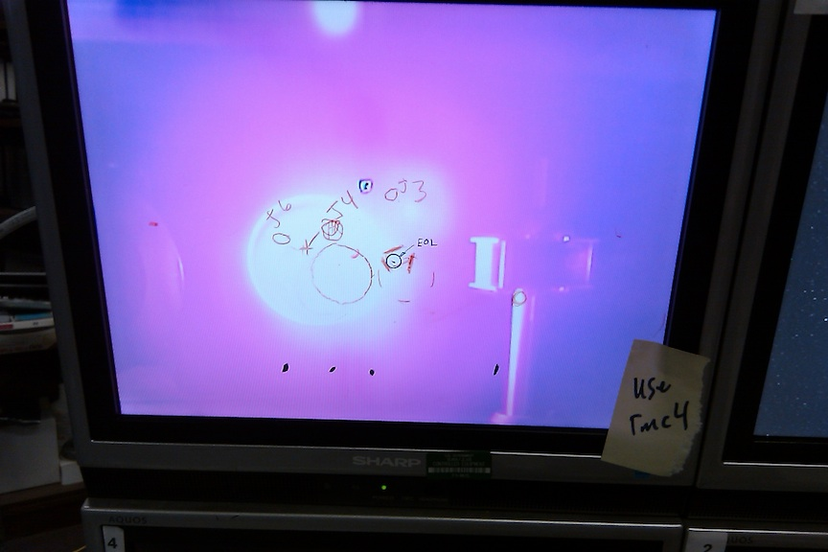
UV System
Commissioned 2010
Shares linac & parts of recirculator with IR Driver ERL - but notionally different machine
  Lower charge (60 pC; better emittance for UV)
  Different nonlinear longitudinal matching process
    “Chicaneless” nonlinear compressor
      No harmonic RF (either system); all (nonlinear) magnetic
60 hours beam time from 1st electrons to CW lasing @ 100+W (700 nm)
FEL performance exceeds predictions (?!?!?)
  Analysis in progress…

Slide 7
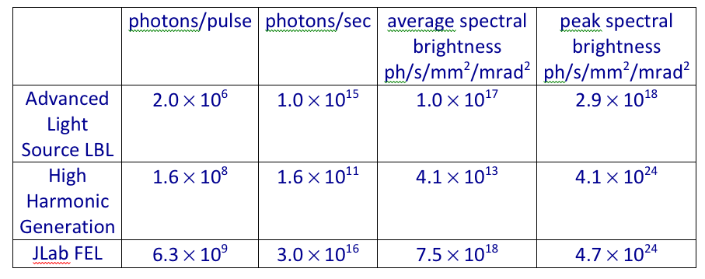
Comparison to other sources
- above table is for 10 eV photon energy, 0.1% bandwidth
- assumes JLab FEL at 4.7 MHz, 230 fs FWHM
Courtesy Gwyn Williams

Slide 8
Longitudinal Matching Scenario
DC Gun
E
Requirements on phase space:
high peak current (short bunch) at FEL
  bunch length compression at wiggler
  using quads and sextupoles to adjust compactions
“small” energy spread at dump
  energy compress while energy recovering
  “short” RF wavelength/long bunch,
  large exhaust δp/p (~10%)
  get slope, curvature, and torsion right
  (quads, sextupoles, octupoles)
φ
E
IR Wiggler
φ
SRF Linac
E
Bunching Chicane
E
φ
E
φ
Dump
E
φ
φ

Slide 9
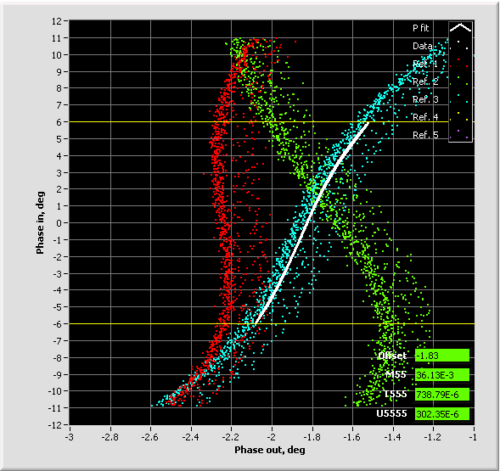
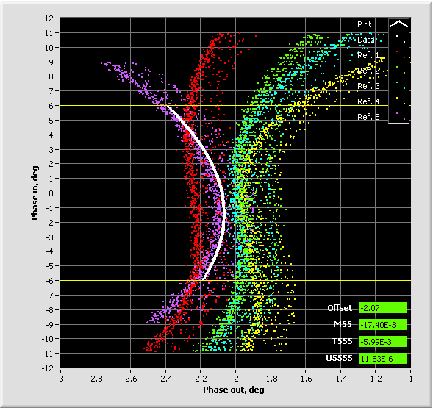
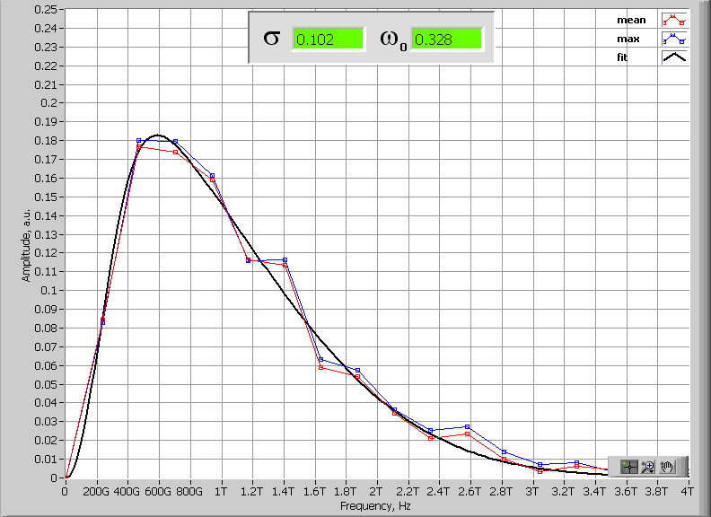
JLab FEL bunch compression and diagnostics
JLab IR/UV Upgrade FEL operates with bunch compression ration of 90-135 (cathode to wiggler); 17-25 (LINAC entrance to wiggler).
To achieve this compression ratio nonlinear compression is used – compensating for LINAC RF curvature (up to 2nd order).
The RF curvature compensation is made with multipoles installed in dispersive locations of 180° Bates bend with separate function magnets - no harmonic RF
Operationally longitudinal match relies on:
a. Bunch length measurements at full compression (Martin-Puplett Interferometer)
b. Longitudinal transfer function measurements R₅₅, T₅₅₅, U₅₅₅₅
c. Energy spread measurements in injector and exit of the LINAC
Trim quads
(B’dL) 740 G
Sextupoles
(B’dL) 12730 G
Trim quads
(B’dL) 700 G
Sextupoles
(B’dL) 10730 G
Trim quads
(B’dL) 660 G
Sextupoles
(B’dL) 8730 G
Martin-Puplett Interferometer data
in frequency domain – give upper limit on the RMS bunch length
Courtesy Pavel Evtushenko

Slide 10
Energy Compression
E
E
E
All e⁻ after trough go into high-energy tail at dump
t
t
t
Beam central energy drops, beam energy spread grows
Recirculator energy must be matched to beam central energy to maximize acceptance
Beam rotated, curved, torqued to match shape of RF waveform
Maximum energy can’t exceed peak deceleration available from linac
  Corollary: entire bunch must preced trough of RF waveform

Slide 11
Higher Order Corrections
Without nonlinear corrections, phase space becomes distorted during deceleration
Curvature, torsion,… can be compensated by nonlinear adjustments
  differentially move phase space regions to match gradient required for energy compression
E
t
Required phase bite is cos⁻¹(1-ΔE_{FEL}/E); this is >25º at the RF fundamental for 10% exhaust energy spread, >30º for 15%
  typically need 3rd order corrections (octupoles)
  also need a few extra degrees for tails, phase errors & drifts, irreproducible & varying path lengths, etc, so that system operates reliably
In this context, harmonic RF very hard to use…

Slide 12
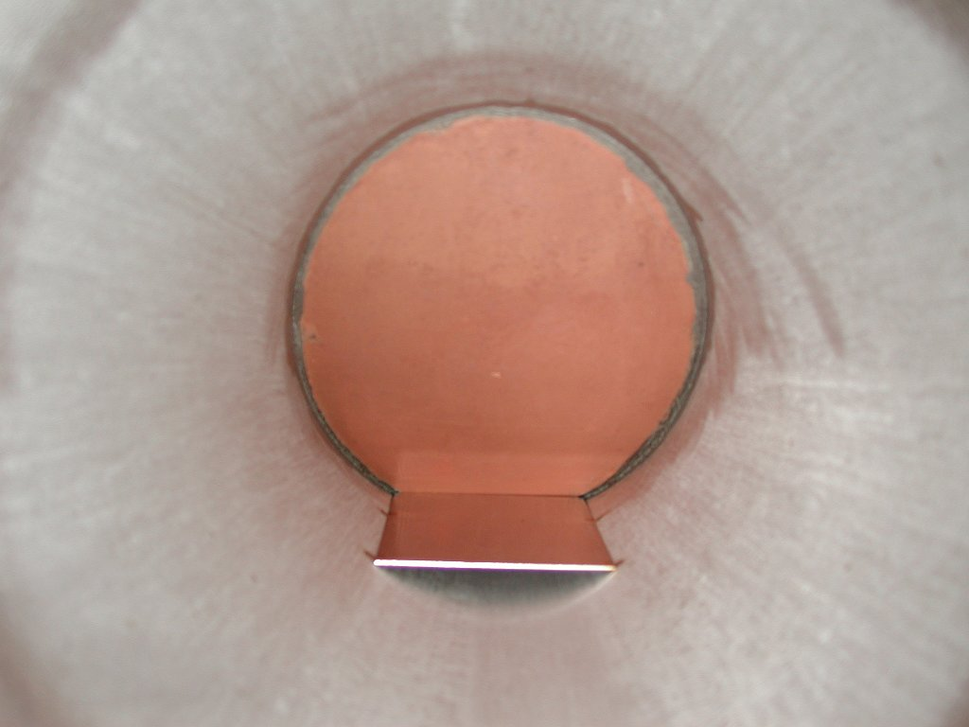
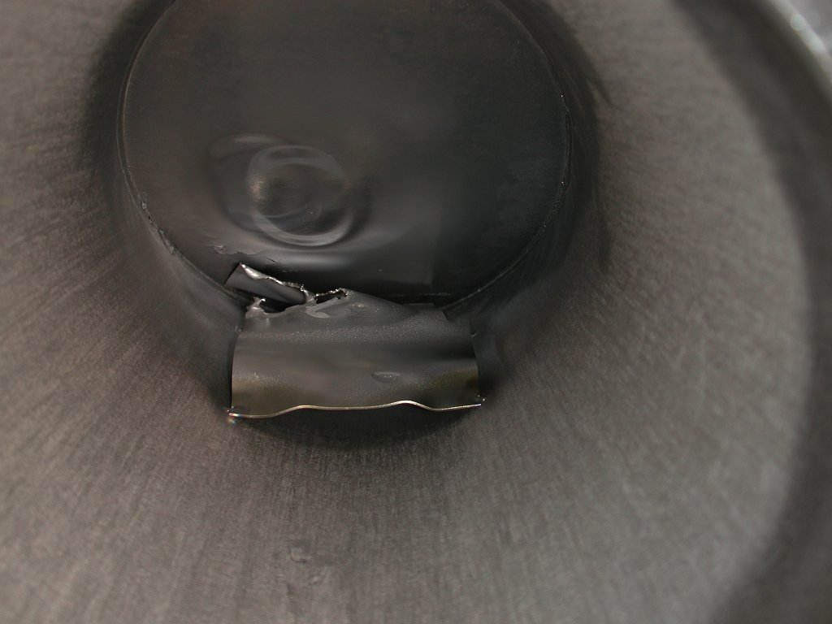
JLab IR Demo Dump
core of beam off center,
even though BLMs showed
edges were centered
(high energy tail)

Slide 13
Prospects
Near term (March-August run)
  Fully funded for FY ‘12 operations
  Multiple accelerator, FEL, & optics experiments on schedule
  Preliminary VUV user run
  Initial tests of NP internal target geometry (DarkLight)
Mid-term (next few years)
  Machine overhaul (partially funded, planning underway)
    new source, SRF
  With sufficient funding have potential for very high performance in UV
    Extend energy, wavelength reach, power

Slide 14
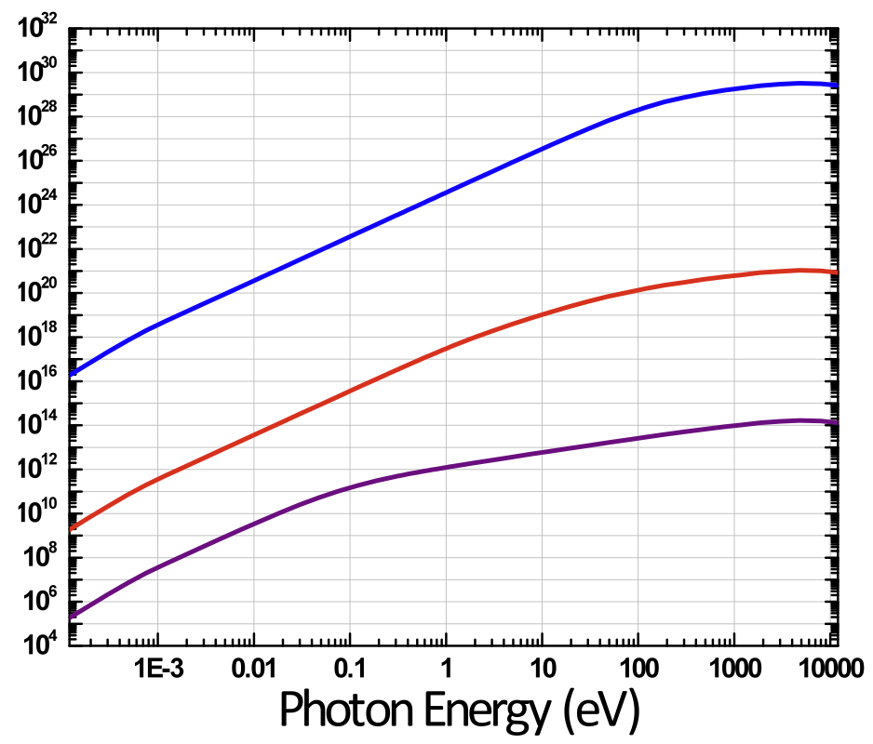
JLab FEL Upgrade #1 (UV Cryomirrors)
cooled mirrors X10
$0.5M
NGLS
JLab FEL
Average Brightness
(photons/sec/mm2/mrad2)
harmonics
JLab THz
Photon Energy (eV)
Courtesy Gwyn Williams

Slide 15
JLab FEL Upgrade #2 (Refurbished source, RF)
higher E
X 1000
$3M
NGLS
JLab FEL
Average Brightness
(photons/sec/mm2/mrad2)
harmonics
JLab THz
Photon Energy (eV)
Courtesy Gwyn Williams

Slide 16
JLab FEL Upgrade #3 (Source, RF upgrade)
Much Higher E
$40M
NGLS
JLab FEL
harmonics
Average Brightness
(photons/sec/mm2/mrad2)
JLab THz
Photon Energy (eV)
Courtesy Gwyn Williams

